Slide 1
Large and Fast: Exploiting Memory Hierarchy
Dr R. R. Maiti
CSIS, BITS-Pilani, Hyderabad

Slide 2
Reducing Cache Misses by More Flexible Placement of Blocks

Slide 3
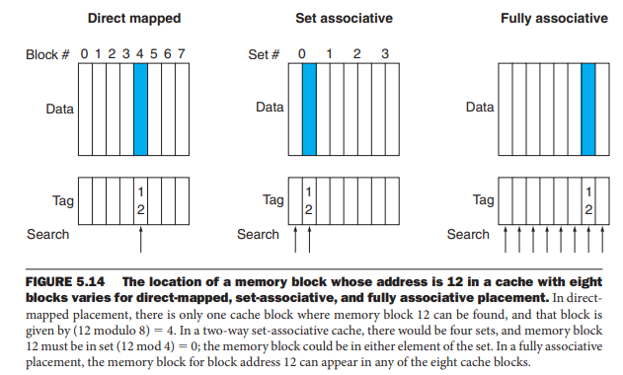
Cache Organization
fully associative cache
A cache structure in which a block can be placed in any location in the cache
set-associative cache
A cache that has a fixed number of locations (at least two) where each block can be placed

Slide 4
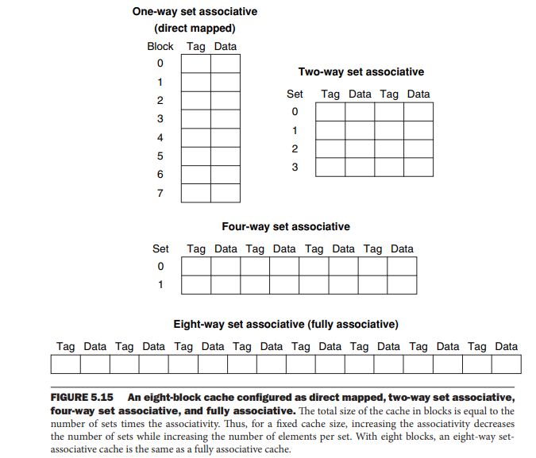
Set Associative Cache Organization

Slide 5
Misses and Associativity in Caches
Assume that
there are three small caches, each consisting of four one-word blocks,
Cache-1 : fully associative
Cache-2 : two-way set-associative
Cache-3 : direct-mapped
Find the number of misses for each cache organization for following sequence of block addresses:
0, 8, 0, 6, and 8

Slide 6
Misses and Associativity in Caches
Assume that
there are three small caches, each consisting of four one-word blocks,
Cache-1 : fully associative
Cache-2 : two-way set-associative
Cache-3 : direct-mapped
Find the number of misses for each cache organization for following sequence of block addresses:
0, 8, 0, 6, and 8
Ans.
Direct Mapped Cache
First, let’s determine to which cache block each block address maps:
Block address Cache block
0 (0 modulo 4) = 0
6 (6 modulo 4) = 2
8 (8 modulo 4) = 0

Slide 7
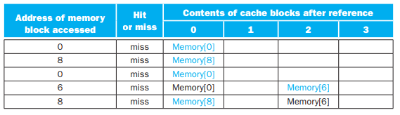
Misses and Associativity in Caches
Assume that
there are three small caches, each consisting of four one-word blocks,
Cache-1 : fully associative
Cache-2 : two-way set-associative
Cache-3 : direct-mapped
Find the number of misses for each cache organization for following sequence of block addresses:
0, 8, 0, 6, and 8
Ans.
Direct Mapped Cache
First, let’s determine to which cache block each block address maps:
Block address Cache block
0 (0 modulo 4) = 0
6 (6 modulo 4) = 2
8 (8 modulo 4) = 0
Direct Mapped Cache
five misses for the five accesses

Slide 8
Locating a Block in the Cache

Slide 9
Locating a Block in the Cache
each block in a set-associative cache includes an address tag that gives the block address
Tags of all the cache blocks within an appropriate set is checked
The index value is used to select the set
the tags of all the blocks in that set must be searched and in parallel
If the total cache size is kept the same,
increasing the associativity increases the number of blocks per set,
This means the number of simultaneous compares is also increased

Slide 10
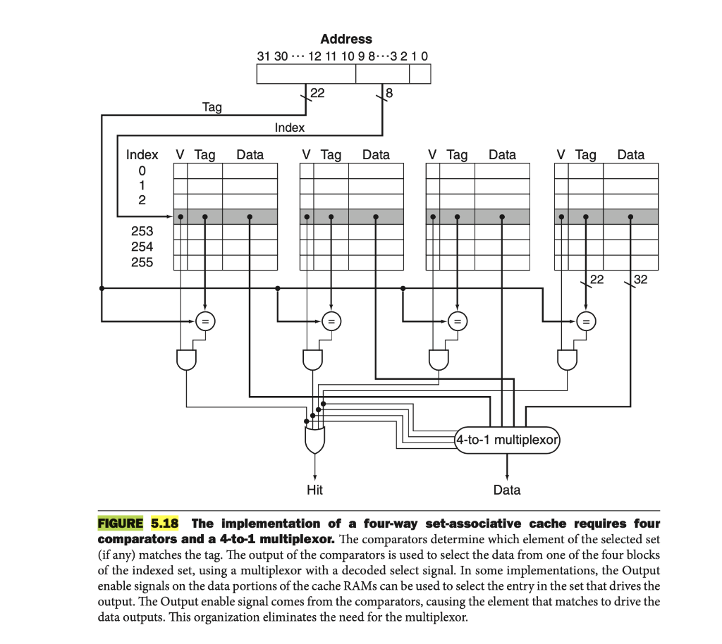
Four-way set associative cache

Slide 11
Choosing Which Block to Replace

Slide 12
Block to Replace
When a miss occurs in a direct-mapped cache,
the requested block can go in exactly one position, so selection required
In an associative cache,
we have a choice of where to place the requested block
In a fully associative cache,
all blocks are candidates for replacement
In a set-associative cache,
we must choose among the blocks in the selected set
The most commonly used scheme
least recently used (LRU):
the block replaced is the one that has been unused for the longest time

Slide 13
Size of Tags versus Set Associativity
Increasing associativity requires more comparators
and reduces the number of sets, which in turn increases tag bits per cache block

Slide 14
Size of Tags versus Set Associativity
Increasing associativity requires more comparators
and reduces the number of sets, which in turn increases tag bits per cache block
Check point
Assuming a cache of 4096 blocks, a 4-word block size, and a 32-bit address, find the total number of sets and the total number of tag bits for caches that are
direct mapped,
two-way and
four-way set associative
fully associative

Slide 15
Check point
4-word block size → 4 x 4 = 16 (= 2⁴ ) bytes/block
32-bit address → 32 - 4 = 28 bits for both index and tag
4096 blocks → 12 bits for block address
The direct-mapped cache has
12 bits of index, since log₂ (4096)= 12
Hence, the total number of tag bits = (28-12) x 4096 = 16 x 4096 = 64 Ki bits

Slide 16
Check point
4-word block size → 4 x 4 = 16 (= 2⁴ ) bytes/block
32-bit address → 32 - 4 = 28 bits for both index and tag
4096 blocks → 12 bits for block address
The direct-mapped cache has
12 bits of index, since log₂ (4096)= 12
Hence, the total number of tag bits = (28-12) x 4096 = 16 x 4096 = 64 Ki bits
Each degree of associativity decreases
the number of sets by a factor of 2 and
thus decreases the number of bits used to index the cache by 1 and
increases the number of bits in the tag by 1

Slide 17
Check point
4-word block size → 4 x 4 = 16 (= 2⁴ ) bytes/block
32-bit address → 32 - 4 = 28 bits for both index and tag
4096 blocks → 12 bits for block address
The direct-mapped cache has
12 bits of index, since log₂ (4096)= 12
Hence, the total number of tag bits = (28-12) x 4096 = 16 x 4096 = 64 Ki bits
Each degree of associativity decreases
the number of sets by a factor of 2 and
thus decreases the number of bits used to index the cache by 1 and
increases the number of bits in the tag by 1
Thus, in a 2-way set-associative cache,
#sets = 2048 → 11 bits for set index
Total #tag bits = (28-11) x 2 x 2048 = 34 x 2048 = 70 Kbits

Slide 18
Check point
4-word block size → 4 x 4 = 16 (= 2⁴ ) bytes/block
32-bit address → 32 - 4 = 28 bits for both index and tag
4096 blocks → 12 bits for block address
The direct-mapped cache has
12 bits of index, since log₂ (4096)= 12
Hence, the total number of tag bits = (28-12) x 4096 = 16 x 4096 = 64 Ki bits
Each degree of associativity decreases
the number of sets by a factor of 2 and
thus decreases the number of bits used to index the cache by 1 and
increases the number of bits in the tag by 1
Thus, in a 2-way set-associative cache,
#sets = 2048 → 11 bits for set index
Total #tag bits = (28-11) x 2 x 2048 = 34 x 2048 = 68 Kibits.
In 4-way set-associative cache,
#sets = 1024 → 10 bits for set index
Total #tag bits = (28 - 10) x 4 x 1024 = 72 x 1024 = 72 Kibits

Slide 19
Check point
4-word block size → 4 x 4 = 16 (= 2⁴ ) bytes/block
32-bit address → 32 - 4 = 28 bits for both index and tag
4096 blocks → 12 bits for block address
The direct-mapped cache has
12 bits of index, since log₂ (4096)= 12
Hence, the total number of tag bits = (28-12) x 4096 = 16 x 4096 = 64 Ki bits
Each degree of associativity decreases
the number of sets by a factor of 2 and
thus decreases the number of bits used to index the cache by 1 and
increases the number of bits in the tag by 1
Thus, in a 2-way set-associative cache,
#sets = 2048 → 11 bits for set index
Total #tag bits = (28-11) x 2 x 2048 = 34 x 2048 = 68 Kibits.
In 4-way set-associative cache,
#sets = 1024 → 10 bits for set index
Total #tag bits = (28 - 10) x 4 x 1024 = 72 x 1024 = 72 Kibits
In fully associative cache,
#sets = 1 and 4096 blocks/set
#tag bits = 28 bits/block
Total #tag bits = 28 x 1 x 4096 = 112 Kibits

Slide 20
Reducing the Miss Penalty Using Multilevel Caches
To close the gap further between the fast clock rates of modern processors and the increasingly long time required to access DRAMs,
most microprocessors support an additional level of caching
This second-level (L2) cache is normally on the same chip
accessed whenever a miss occurs in the primary cache
If the second-level cache contains the desired data,
the miss penalty for the first-level cache will be essentially the access time of the second-level cache, which will be much less than the access time of main memory

Slide 21
Check Point
Suppose we have a processor with a base CPI of 1.0,
assuming all references hit in the primary cache, and a clock rate of 4 GHz
Assume a main memory access time of 100 ns,
including all the miss handling
Suppose the miss rate per instruction at the primary cache is 2%
How much faster will the processor be if we add a secondary cache that has a 5 ns access time for either a hit or a miss and is large enough to reduce the miss rate to main memory to 0.5%?

Slide 22
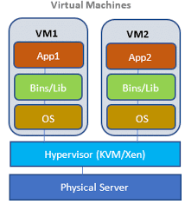

Virtual Machines

Slide 23
Virtual Machines
Virtual Machines (VM) were first developed in the mid-1960s,
VMs have remained an important part of mainframe computing over the years
VM recently gained popularity due to
The increasing importance of isolation and security in modern systems
The failures in security and reliability of standard operating systems
The sharing of a single computer among many unrelated users
The dramatic increases in raw speed of processors over the decades, which makes the overhead of VMs more acceptable

Slide 24

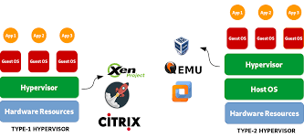
VM
we are interested in VMs that provide
a complete system-level environment at the binary instruction set architecture (ISA) level
Some VMs run different ISAs from the native hardware
they always match the hardware
These VMs are called (Operating) System Virtual Machines
Examples: IBM VM/370, VirtualBox, VMware ESX Server, and Xen
System virtual machines present the illusion that
the users have an entire computer to themselves, including a copy of the OS
On a conventional platform,
a single OS “owns” all the hardware resources,
but with a VM, multiple OSes share the same hardware resources
The software that supports VMs is called a
virtual machine monitor (VMM) or
hypervisor

Slide 25
VMs for improving protection
VMs provide two other benefits that are commercially significant:
Managing software.
VMs provide an abstraction that can run the complete software stack, even including old operating systems like DOS.
Managing hardware.
VMs allow separate software stacks to run independently yet share hardware, thereby consolidating a number of servers
An example is that some VMMs support migration of a running VM to a different computer, either to balance load or to evacuate from failing hardware

Slide 26
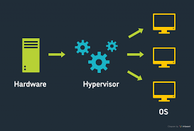
Requirements of a Virtual Machine Monitor (VMM)
What must a VM monitor (VMM) do?
It presents a software interface to guest software
it must isolate the state of guests from each other
it must protect itself from guest software
The qualitative requirements are:
Guest software should behave on a VM exactly as if it were running on the native hardware, except for performance-related behavior or limitations of fixed resources shared by multiple VMs.
Guest software should not be able to change allocation of real system resources directly

Slide 27
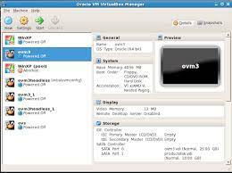
VMM must be at a higher privilege
To be in charge,
the VMM must be at a higher privilege level than the guest VM, which generally runs in user mode;
the execution of any privileged instruction will be handled by the VMM
The basic requirements of system virtual:
At least two processor modes, system and user.
A privileged subset of instructions that is available only in system mode, resulting in a trap if executed in user mode;
all system resources must be controllable only via these instructions

Slide 28
(Lack of) Instruction Set Architecture Support for Virtual Machines
If VMs are planned for during the design of the ISA,
it’s relatively easy to reduce both the number of instructions that must be executed by a VMM and improve their emulation speed
An architecture that allows the VM to execute directly on the hardware earns the title virtualizable,
Example: the IBM 370 architecture
Alas, since VMs have been considered for PC and server applications only fairly recently,
most instruction sets were created without virtualization in mind
Instructions sets (ISA) without virtualization
x86
most RISC architectures, like ARMv7 and MIPS

Slide 29
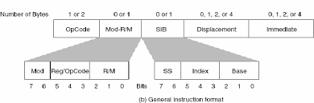
Protection and Instruction Set Architecture
Protection is a joint effort of architecture and operating systems,
The architects had to modify some awkward details of existing instruction set architectures when virtual memory became popular
For example,
the x86 instruction POPF loads the flag registers from the top of the stack in memory
One of the flags is the Interrupt Enable (IE) flag
If you run the POPF instruction in user mode, rather than trap it, it simply changes all the flags except IE
In system mode, it does change the IE
Since a guest OS runs in user mode inside a VM,
this is a problem, as it expects to see a changed IE

Slide 30
Protection and Instruction Set Architecture
Historically, IBM mainframe hardware and VMM took three steps to improve performance of virtual machines:
1. Reduce the cost of processor virtualization
2. Reduce interrupt overhead cost due to the virtualization
3. Reduce interrupt cost by steering interrupts to the proper VM without invoking VMM

Slide 31
Virtual Memory

Slide 32
Virtual memory
the main memory can act as a “cache” for the secondary storage, usually implemented with magnetic disks
This technique is called virtual memory
two major motivations for virtual memory:
to allow efficient and safe sharing of memory among multiple programs,
such as for the memory needed by multiple virtual machines for cloud computing
to remove the programming burdens of a small, limited amount of main memory
Main memory need to contain only the active portions of the many VMs,
just as a cache contains only the active portion of one program
Virtual memory translates a program’s address space to physical addresses
This translation process enforces protection of a program’s address space from other virtual machines

Slide 33
Terms
A virtual memory block is called a page,
and a virtual memory miss is called a page fault
With virtual memory,
the processor produces a virtual address,
virtual address is translated by a combination of hardware and software to a physical address
Physical address then used to access main memory
Two memory hierarchy levels controlled by virtual memory are
Personal mobile devices : usually DRAMs and flash memory
Servers: DRAMs and magnetic disks
All virtual memory systems in use today relocate the program as a set of fixed-size blocks (pages),
thereby eliminating the need to find a contiguous block of memory to allocate to a program
instead, the operating system need only find a sufficient number of pages in main memory

Slide 34
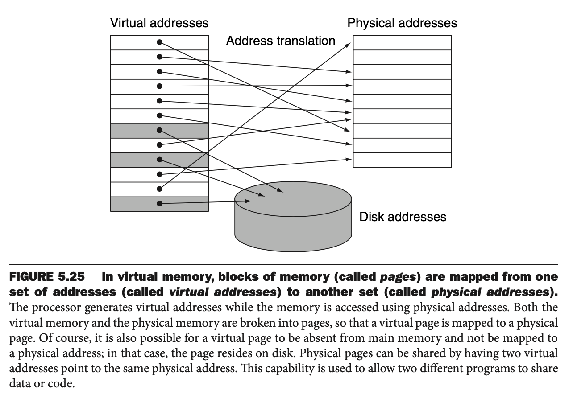
Virtual to Physical address

Slide 35
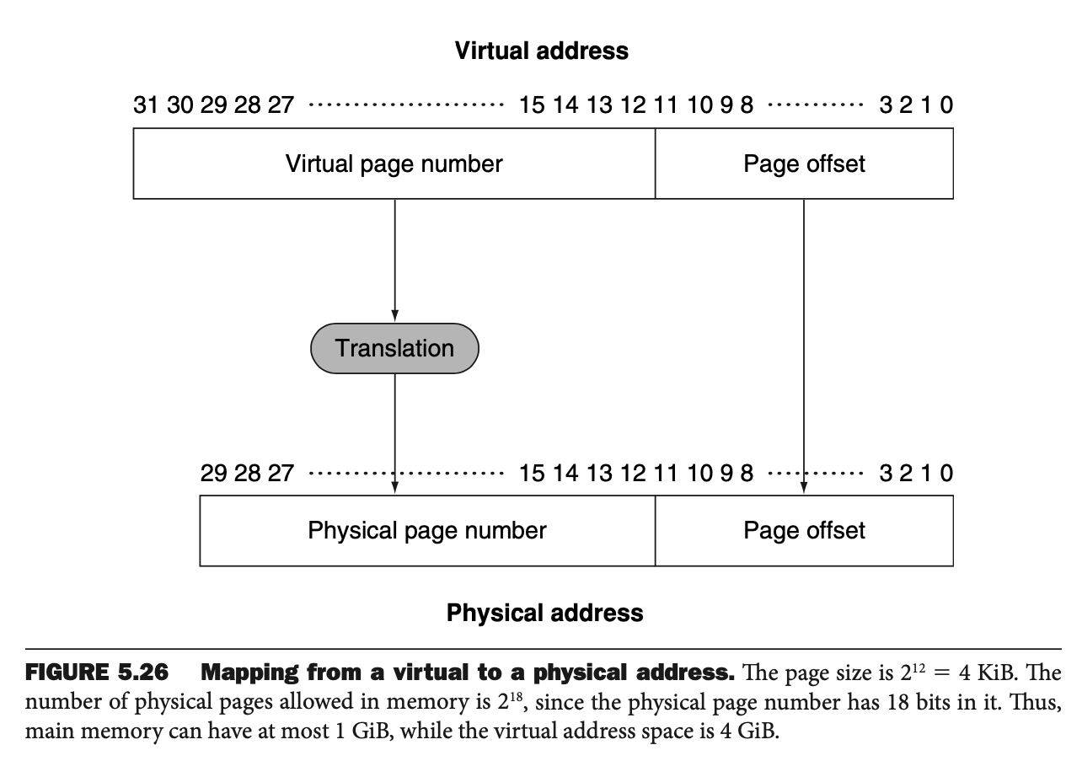
Address bits

Slide 36
key decisions in designing virtual memory
Many design choices in virtual memory systems are motivated by the high cost of a page fault
A page fault to disk will take millions of clock cycles to process
several key decisions in designing virtual memory systems:
Pages should be large enough to try to amortize the high access time
PC or server: 4 KiB to 16 KiB
Embedded systems : 1 KiB pages
Organizations that reduce the page fault rate are attractive.
The primary technique used here is to allow fully associative placement of pages in memory
Page faults can be handled in software because the overhead will be small compared to the disk access time
Write-through will not work for virtual memory,
since writes take too long
Instead, virtual memory systems use write-back

Slide 37
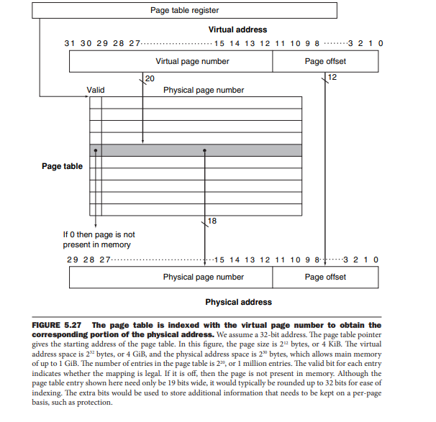
Page Table
The table containing the virtual to physical address translations in a virtual memory system
The page table is stored in memory
The page table is typically indexed by the virtual page number
each entry = the physical page number + valid bit
No tags are required for any entry
The index to access the page table is the full block address
This is the virtual page number

Slide 38
Page Faults

Slide 39
Page Faults
If the valid bit for a virtual page is off ,
a page fault occurs
The operating system must be given control
This transfer is done with the exception mechanism
Once the operating system gets control,
it must find the page in the next level of the hierarchy (usually flash memory or magnetic disk) and
decide where to place the requested page in main memory
Because we do not know ahead of time when a page in memory will be replaced,
the operating system usually creates the space on flash memory or disk for all the pages of a process when it creates the process
This space is called the swap space
At that time,
it also creates a data structure to record where each virtual page is stored on disk
This data structure may be part of the page table or may be an auxiliary data structure indexed in the same way as the page table
The operating system also creates a data structure that tracks which processes and which virtual addresses use each physical page
When a page fault occurs, if all the pages in main memory are in use, the operating system must choose a page to replace

Slide 40
least recently used (LRU)
least recently used (LRU) replacement scheme
a page that has not been used in a long time is less likely to be needed than a more recently accessed page
Implementing a completely accurate LRU scheme is too expensive,
it requires updating a data structure on every memory reference
An approximate LRU
some computers provide a reference bit or use bit,
set whenever a page is accessed
OS periodically clears the reference bits and later records them so it can determine which pages were touched during a particular time period

Slide 41
What about Writes?
In a virtual memory system,
writes to the next level of the hierarchy (disk) can take millions of processor clock cycles
therefore, building a write buffer to allow the system to write-through to disk would be completely impractical
Instead, virtual memory systems must use write-back,
the individual writes are performed into the page in memory, and copying the page back to disk when it is replaced in the memory
Copying back an entire page is much more efficient than writing individual words
A write-back operation is still costly
To track whether a page has been written since it was read into the memory,
a dirty bit is added to the page table
The dirty bit is set when any word in a page is written
the page needs to be written out before its replacement
Hence, a modified page is often called a dirty page

Slide 42
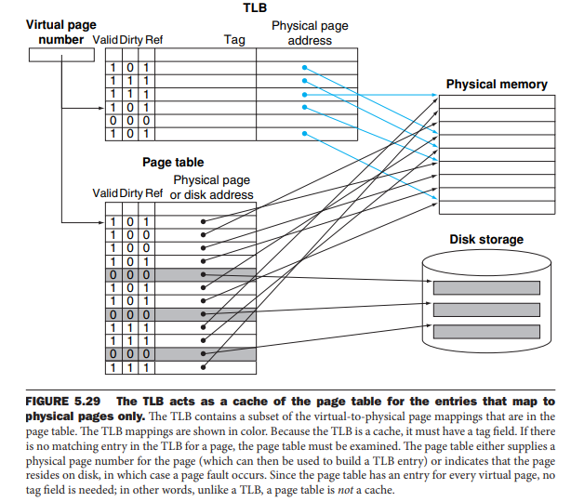
Making Address Translation Fast: the TLB
Since the page tables are stored in main memory,
every memory access by a program can take at least twice as long:
one to get the physical address
Another get the data
modern processors include a special cache that keeps track of recently used translations
translation-lookaside buffer (TLB)

Slide 43
TLB miss
After a TLB miss occurs
the missing translation is retrieved from the page table
select a TLB entry to replace with retrieved translation
Because the reference and dirty bits are contained in the TLB entry,
we need to copy these bits back to the page table entry when we replace an entry from TLB

Slide 44
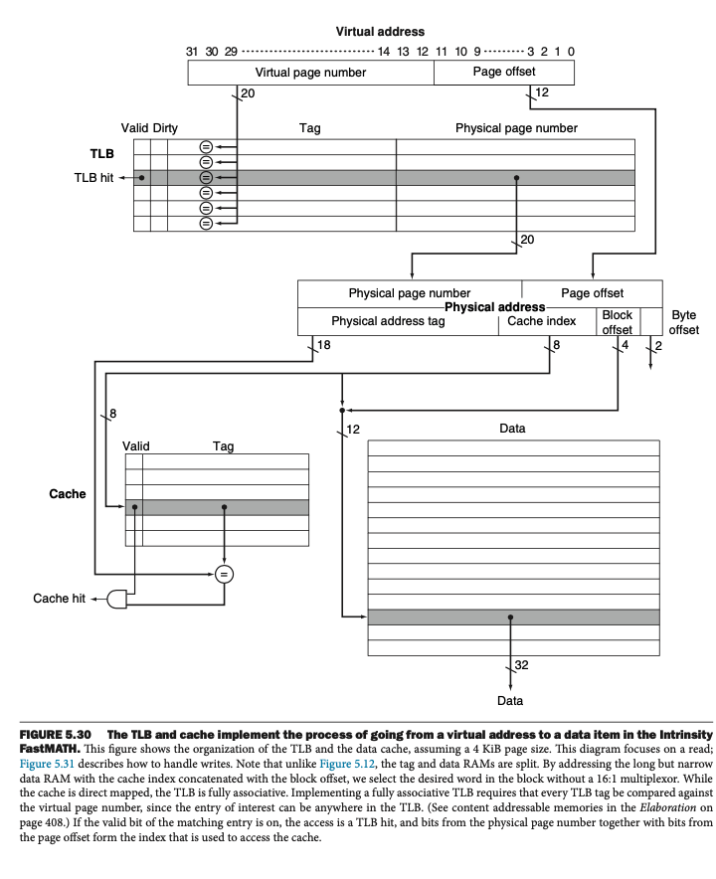
Integrating Virtual Memory, TLBs, and Caches

Slide 45
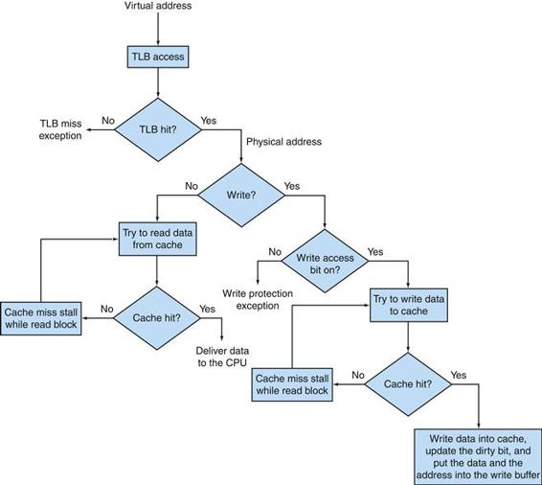
Integrating Virtual Memory, TLBs, and Caches
If the TLB generates a hit, the cache can be accessed with the resulting physical address.
For a read, the cache generates a hit or miss and supplies the data or causes a stall
while the data is brought from memory.
If the operation is a write, a portion of the cache entry is overwritten for a hit and the data is sent to the write buffer if we assume write-through.
A write miss is just like a read miss except that the block is modified after it is read from memory.
Write-back requires writes to set a dirty bit for the cache block, and a write buffer is loaded with the whole block only on a read miss or write miss if the block to be replaced is dirty.
Notice that a TLB hit and a cache hit are independent events, but a cache hit can only occur after a TLB hit occurs, which means that the data must be present in memory.

Slide 46
Finite-State Machine to Control a Simple Cache

Slide 47
A Simple Cache
Design elements
Direct-mapped cache
Write-back using write allocate
Block size is 4 words (16 bytes or 128 bits)
Cache size is 16 KiB, so it holds 1024 blocks
32-byte addresses
The cache includes a valid bit and dirty bit per block
Calculate the fields of an address for the cache
Cache index is 10 bits
Block offset is 4 bits
Tag size is 32 - (10 + 4) or 18 bits
The signals between the processor to the cache are
1-bit Read or Write signal
1-bit Valid signal, saying whether there is a cache operation or not
32-bit address
32-bit data from processor to cache
32-bit data from cache to processor
1-bit Ready signal, saying the cache operation is complete

Slide 48
A Simple Cache
Design elements
Direct-mapped cache
Write-back using write allocate
Block size is 4 words (16 bytes or 128 bits)
Cache size is 16 KiB, so it holds 1024 blocks
32-byte addresses
The cache includes a valid bit and dirty bit per block
Calculate the fields of an address for the cache
Cache index is 10 bits
Block offset is 4 bits
Tag size is 32 - (10 + 4) or 18 bits
The signals between the processor to the cache are
1-bit Read or Write signal
1-bit Valid signal, saying whether there is a cache operation or not
32-bit address
32-bit data from processor to cache
32-bit data from cache to processor
1-bit Ready signal, saying the cache operation is complete
The interface between the memory and the cache has the same fields as between the processor and the cache,
except that the data fields are now 128 bits wide
Making the cache block match the width of the DRAM simplified the design
the signals between memory and cache are
1-bit Read or Write signal
1-bit Valid signal, saying whether there is a memory operation or not
32-bit address
128-bit data from cache to memory
128-bit data from memory to cache
1-bit Ready signal, saying the memory operation is complete

Slide 49
FSM Arrangement
A finite-state machine can be implemented with
a temporary register that holds the current state and
a block of combinational logic that determines both
the data-path signals to be asserted and
the next state

Slide 50
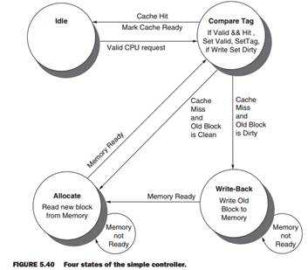
FSM for a Simple Cache Controller
Idle: This state waits for a valid read or write request from the processor, which moves the FSM to the Compare Tag state

Slide 51
FSM for a Simple Cache Controller
Compare Tag: Check if the requested read or write is a hit or a miss. The index portion of the address selects the tag to be compared.
If the data in the cache block referred to by the index portion of the address is valid, and the tag portion of the address matches the tag, then it is a hit.
Either the data is read from the selected word if it is a load or written to the selected word if it is a store. The Cache Ready signal is then set. If it is a write, the dirty bit is set to 1. Note that a write hit also sets the valid bit and the tag field; while it seems unnecessary, it is included because the tag is a single memory, so to change the dirty bit we also need to change the valid and tag fields.
If it is a hit and the block is valid, the FSM returns to the idle state.
A miss first updates the cache tag and then goes either to the Write-Back state, if the block at this location has dirty bit value of 1, or to the Allocate state if it is 0.

Slide 52
FSM for a Simple Cache Controller
Write-Back: This state writes the 128-bit block to memory using the address composed from the tag and cache index. We remain in this state waiting for the Ready signal from memory. When the memory write is complete, the FSM goes to the Allocate state.

Slide 53
FSM for a Simple Cache Controller
Allocate: The new block is fetched from memory. We remain in this state waiting for the Ready signal from memory.
When the memory read is complete, the FSM goes to the Compare Tag state.
Although we could have gone to a new state to complete the operation instead of reusing the Compare Tag state, there is a good deal of overlap, including the update of the appropriate word in the block if the access was a write.

Slide 54
Cache coherence

Slide 55
Cache coherence
Given that a multicore multiprocessor
i.e., a single chip contains multiple processors
the processors very likely share a common physical address space
Caching shared data introduces a new problem,
because the view of memory held by two different processors is through their individual caches, which, without any additional precautions, could end up seeing two different values
This difficulty is generally referred to as
the cache coherence problem

Slide 56
Coherent memory
A memory system is coherent if
A read by a processor P to a location X that follows a write by P to X, with no writes of X by another processor occurring between the write and the read by P, always returns the value written by P. Thus, if CPU A were to read X after time step 3, it should see the value 1.
A read by a processor to location X that follows a write by another processor to X returns the written value if the read and write are sufficiently separated in time and no other writes to X occur between the two accesses. Thus, we need a mechanism so that the value 0 in the cache of CPU B is replaced by the value 1 after CPU A stores 1 into memory at address X in time step 3
Writes to the same location are serialized; that is, two writes to the same location by any two processors are seen in the same order by all processors. For example, if CPU B stores 2 into memory at address X after time step 3, processors can never read the value at location X as 2 and then later read it as 1

Slide 57
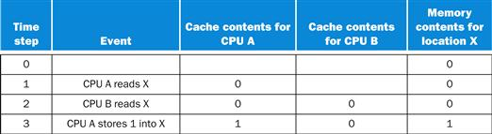
Cache Coherence
We initially assume that neither cache contains the variable and that X has the value 0.
We also assume a write-through cache; a write-back cache adds some additional but similar complications.
After the value of X has been written by A, A’s cache and the memory both contain the new value, but B’s cache does not, and if B reads the value of X, it will receive 0!

Slide 58
Basic Schemes for Enforcing Coherence
Two schemes
migration and replication of shared data items
Migration:
A data item can be moved to a local cache and used there in a transparent fashion
Migration reduces both the latency to access a shared data item that is allocated remotely and the bandwidth demand on the shared memory
Replication:
When shared data are being simultaneously read, the caches make a copy of the data item in the local cache
Replication reduces both latency of access and contention for a read shared data item

Slide 59
cache coherence protocols
The protocols to maintain coherence for multiple processors are called cache coherence protocols
The most popular cache coherence protocol is snooping
Every cache that has a copy of the data from a block of physical memory also has a copy of the sharing status of the block, but no centralized state is kept.
The caches are all accessible via some broadcast medium (a bus or network), and all cache controllers monitor or snoop on the medium to determine whether or not they have a copy of a block that is requested on a bus or switch access

Slide 60
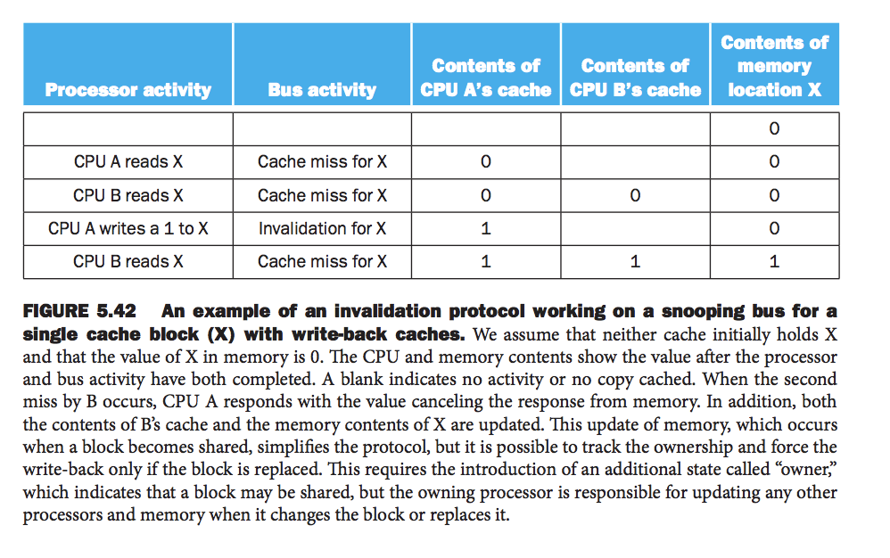
Snooping Protocols
a processor has exclusive access to a data item before it writes that item
This style of protocol is called a write invalidate protocol because it invalidates copies in other caches on a write
Exclusive access ensures that no other readable or writable copies of an item exist when the write occurs:
all other cached copies of the item are invalidated

Slide 61


